Slide 1
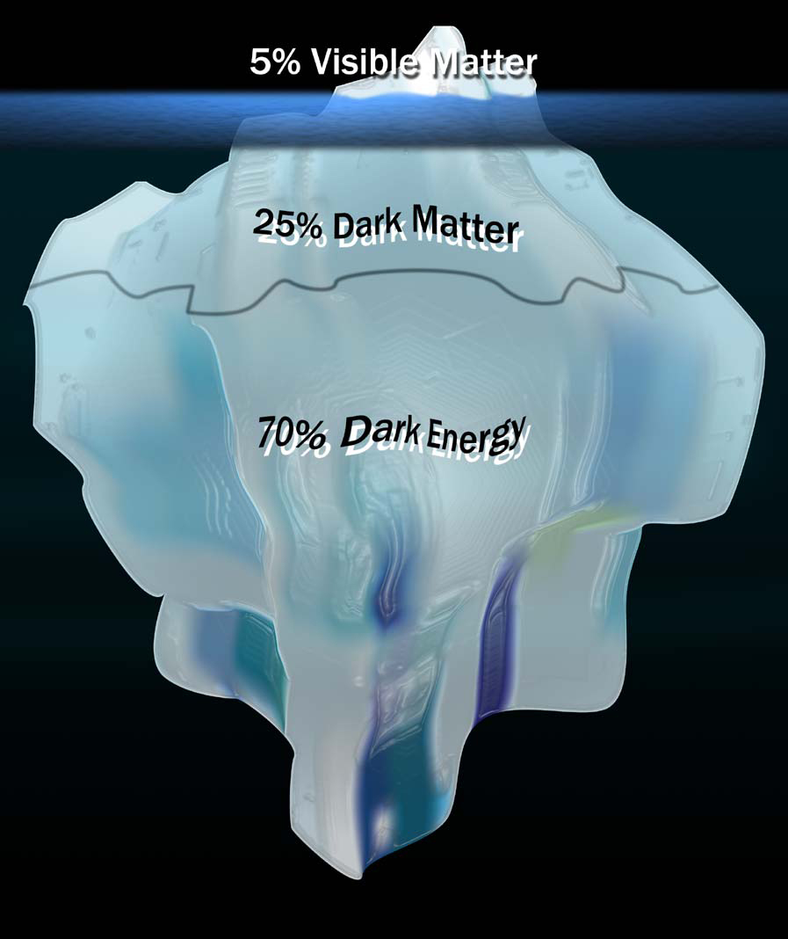
Searching for the rest of the Universe: Dark Matter
Astronomy on Tap ATX
20 Sept 2016

Slide 2
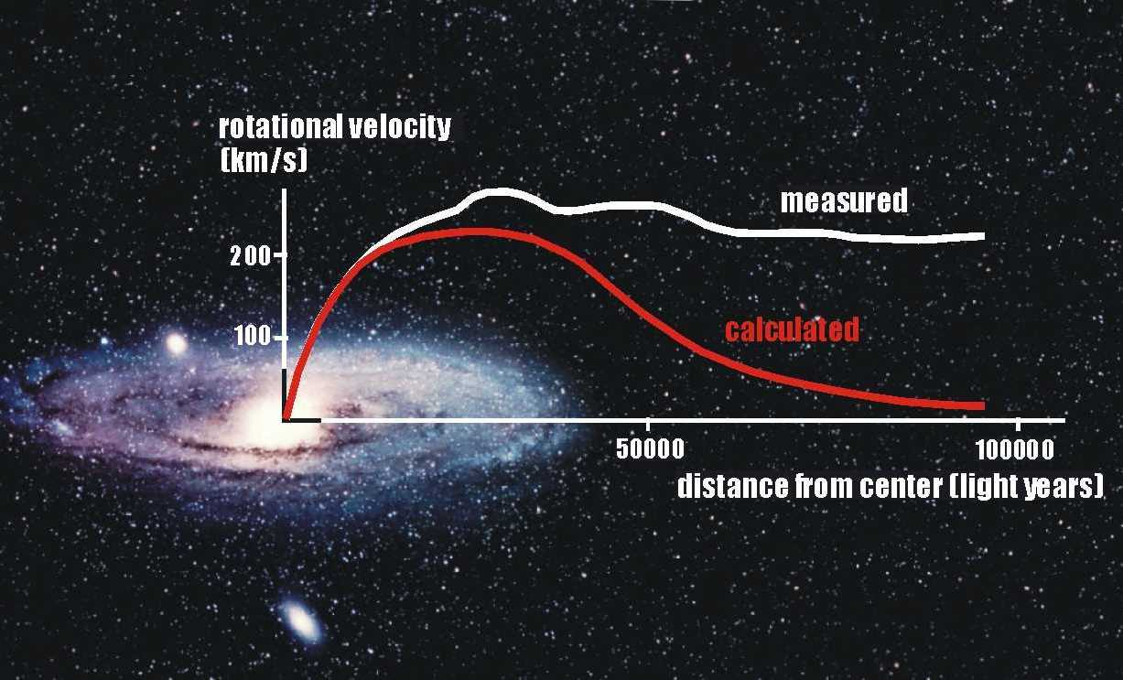
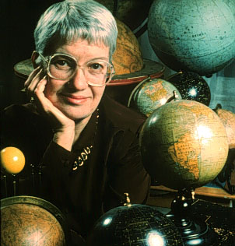
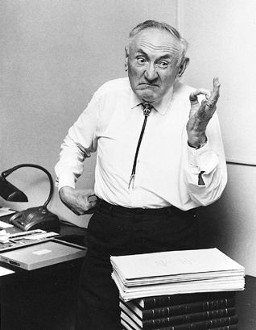
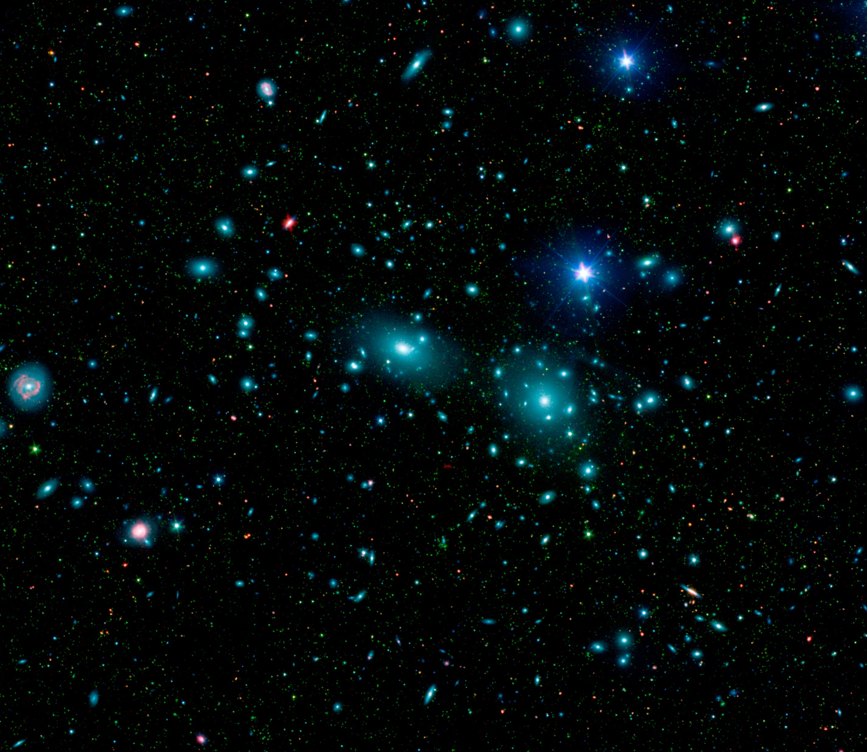
Dark Matter’s Gravitational Effects

Slide 3
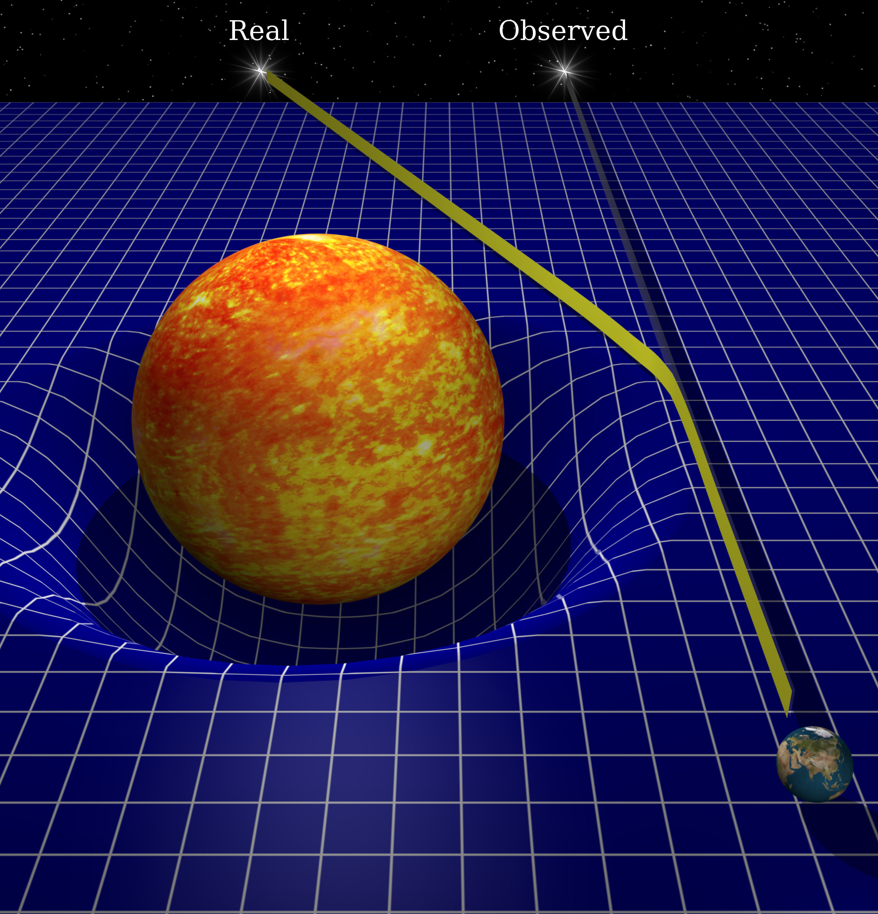
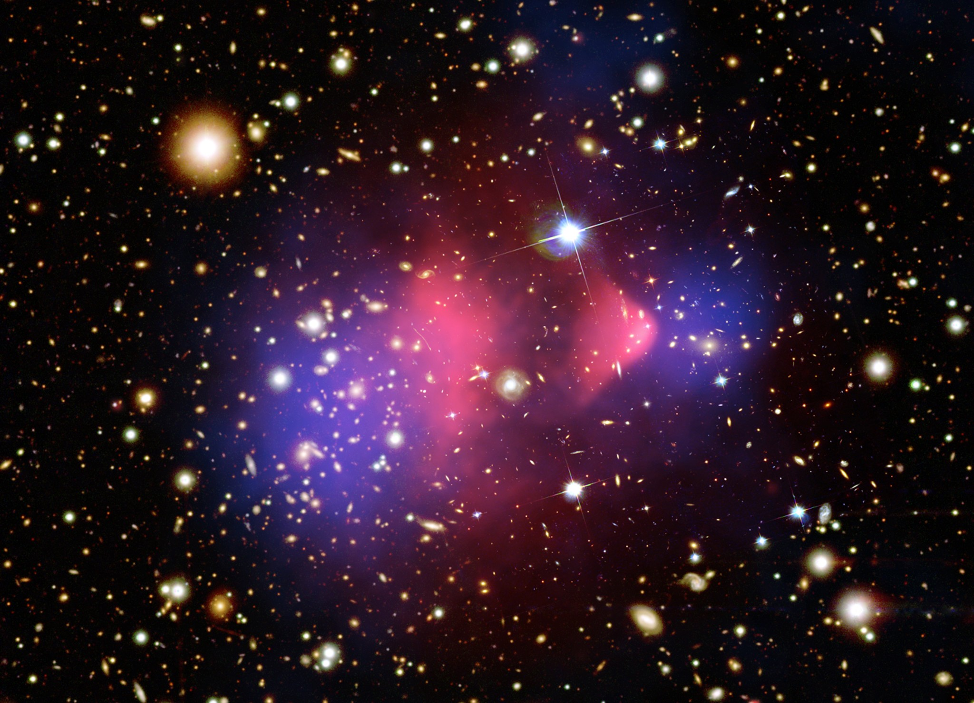
Lensing & the Bullet Cluster
dark = doesn’t interact with light
(except via gravity)
Blue = Gravitating Mass
Red = Hot Gas

Slide 4
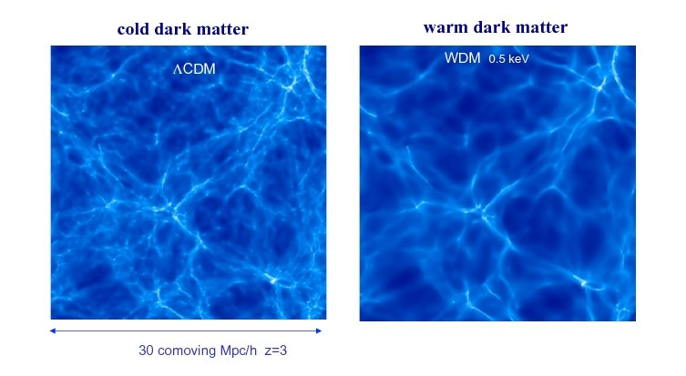
Cosmological Simulations
cold (or warm)
=
DM moves slowly
=
very massive particles
Bright = Lots of Galaxies

Slide 5
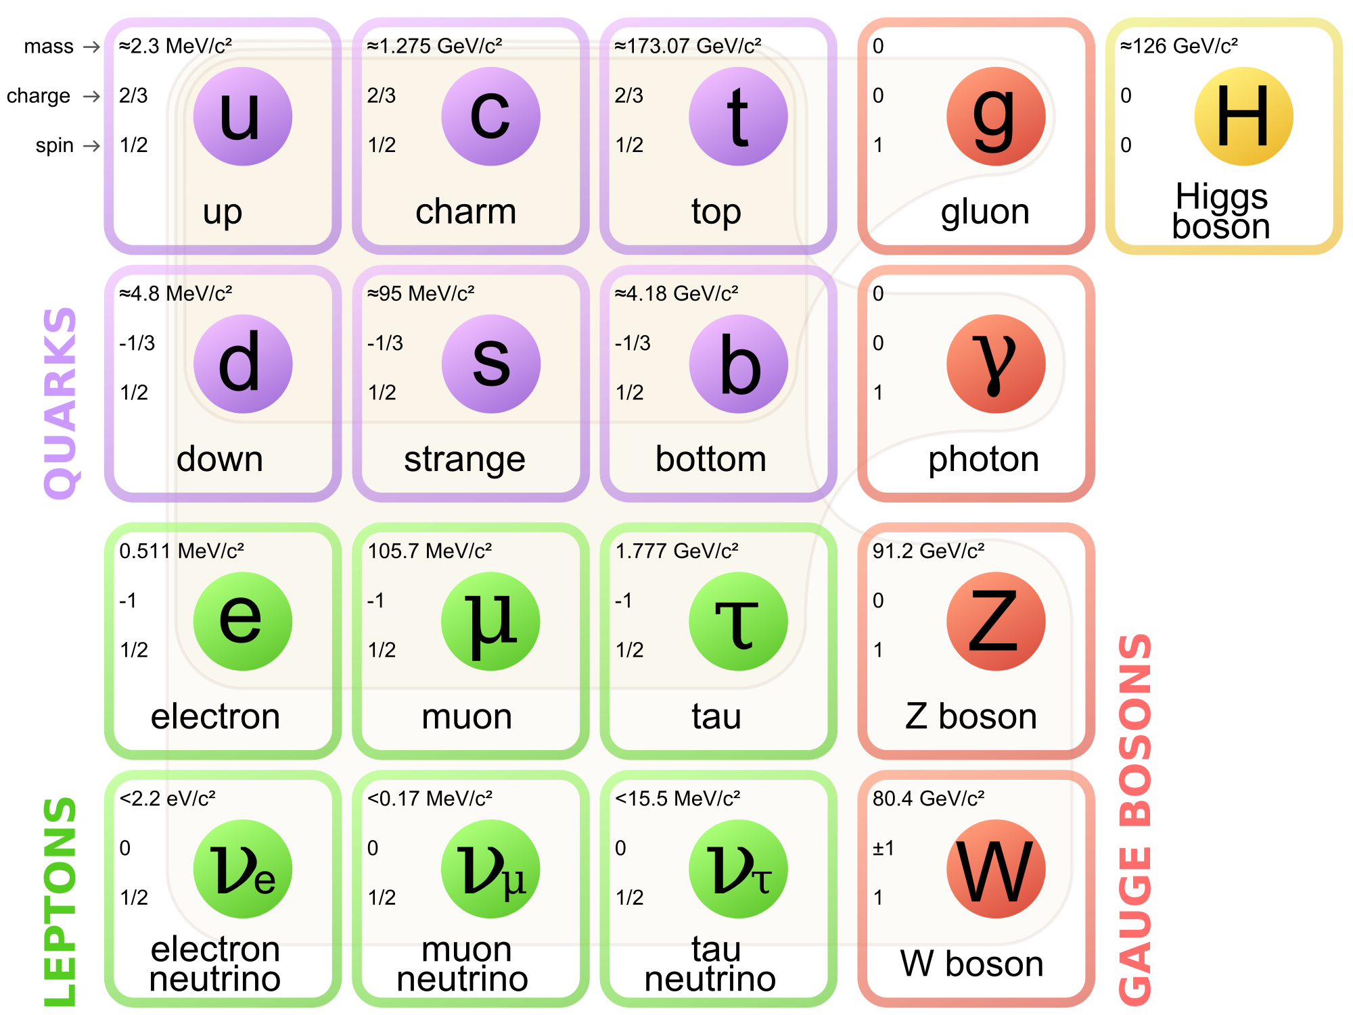
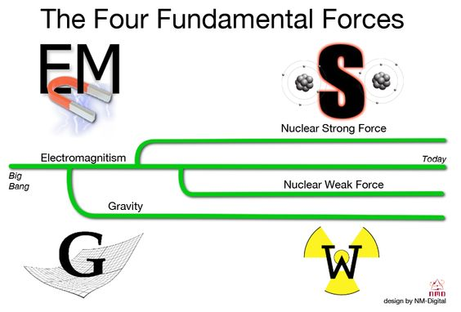
Forces & Particles
Most Normal Matter (atoms)
G
Graviton

Slide 6
Interactions for Dark Matter
?
?
DM
DM?
DM?

Slide 7
Strong Force
u
d
u
u
u
u
d
u
u
u

Slide 8


Weak Force
u
u
d
d
d
u
$${\text{e} }^{−}$$
$${\text{ν} }^{0}$$

Slide 9
Direct Detection Experiments
LUX
CDMS
DM
Fancy
Electronics
Germanium Crystal
Xenon Gas
Heat,
Light
Superconductor
Light Detectors

Slide 10
Direct Search Results
Maybe?
NOPE!
(Experiments)
Dark Matter Particle Size (cm^2)
NOPE!
(neutrinos)
Maybe?

Slide 11
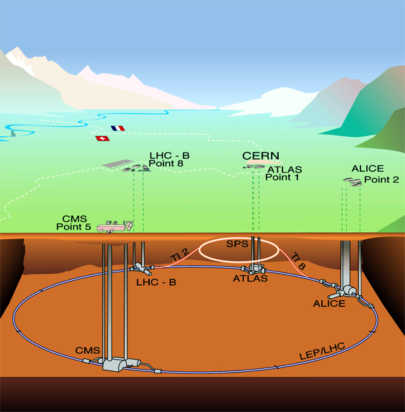
Indirect Searches
DM

Slide 12

Indirect Search Results

Slide 13
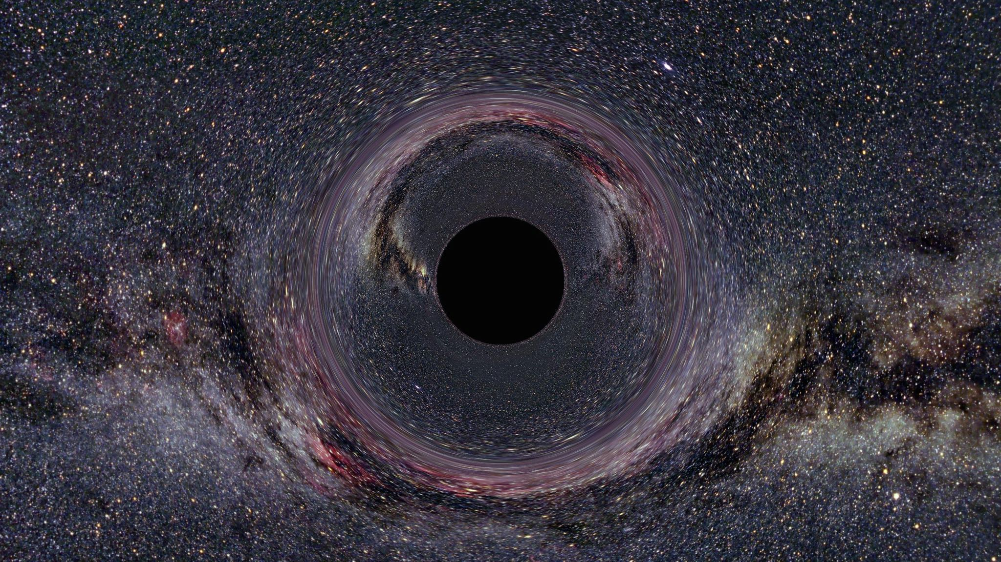
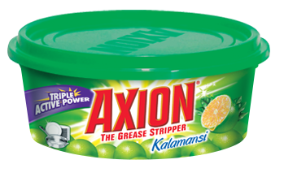
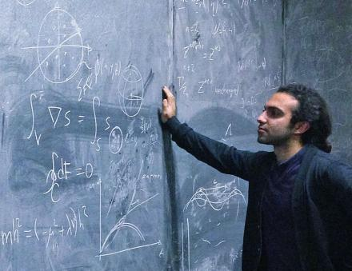
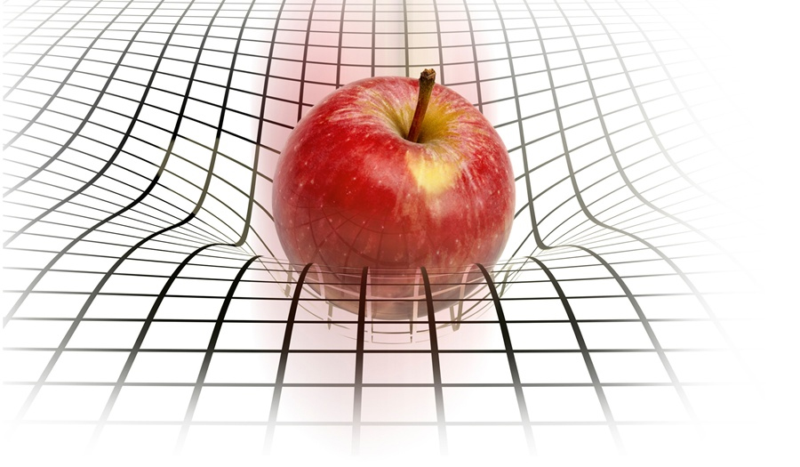

Other possibilities?

